Slide 1
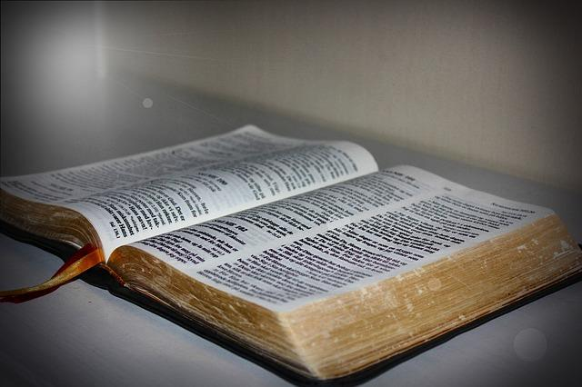
God Said It - I Believe It - That Settles It!
It is a good thought. It conveys the message that since God said it, then I believe it. It is then “settled” because I will not argue with my God about it, nor will I listen to anyone who may try to get me to question His word. However…
Notes:
Sermon inspired by an article by Jarrod Jacobs by the same Title…
Preached at West Side on March 9, 2014 AM
Print Slides: 1,4,7

Slide 2
Consider the following about God’s Word . . .
When God speaks the truth, it is settled (Psalm 119:89)

Slide 3
Psalm 119:89
Forever, O Lord, Your word is settled in heaven.
(Note: This means that men have no right to arbitrarily change any aspect of God’s will, as men are wont to do in our day… Redefining marriage, the gospel, morality, fellowship, what is and is not sin, even usurping the right to decide who lives and dies, etc., etc., etc.)
We know better today?

Slide 4
Consider the following about God’s Word . . .
When God speaks the truth, it is settled (Psalm 119:89)
If one fights and argues against the will of God, a man’s “unsettled” mind has no effect upon God’s truth (cf: 2 Kings 5:9-14, READ)
At the same time, when one accepts God’s word completely, the acceptance and obedience to His word had no effect on the truth, either (Acts 2:41, 47)!

Slide 5
Acts 2:41, 47
(41), “Then those who gladly received his word were baptized; and that day about three thousand souls were added to them.
(47), …And the Lord added to the church daily those who were being saved.
(Note: Their response did not legitimize the truth. It was true anyway. It was the Lord who did the adding, not men!)

Slide 6
Good Better
God Said It - I Believe It - That Settles It!
God Said It - That Settles It - I Believe It!

Slide 7
Conclusion
God’s word has been man’s standard from the beginning. So long as we live upon this earth, this standard will not change.
(Matthew 24:35; 1 Peter 4:11).

Slide 8
Matthew 24:35
Heaven and earth will pass away, but My words will by no means pass away.
Whether warnings of impending judgment, or promises of blessings, God’s word is immutable and enduring!

Slide 9
1 Peter 4:11
If anyone speaks, let him speak as the oracles of God. If anyone ministers, let him do it as with the ability which God supplies, that in all things God may be glorified through Jesus Christ, to whom belong the glory and the dominion forever and ever. Amen.
God Said It – That Settles It… I Had Better Believe It!

